Slide 1
ATTENDANCE APP
Computer vision project

Slide 2
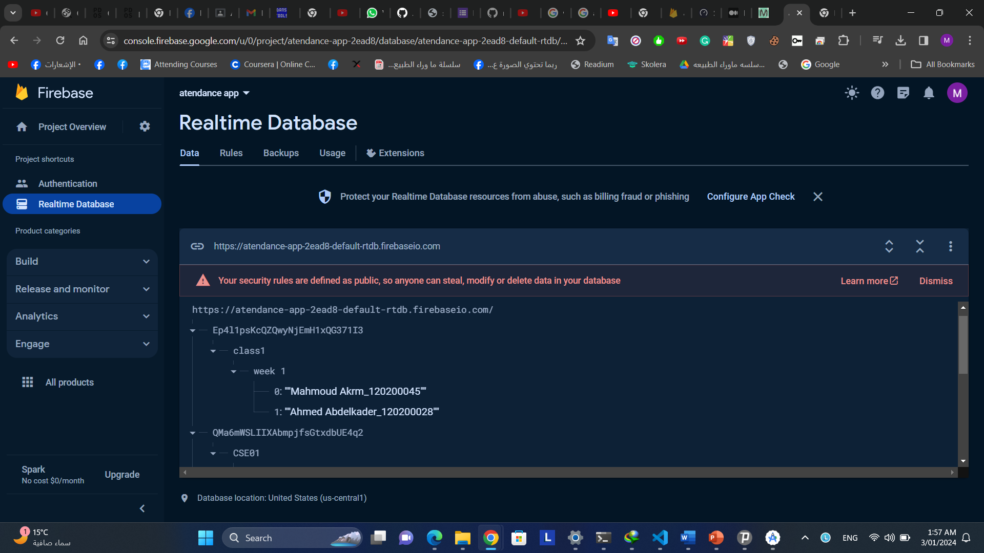


firebase
real time database is used to save all our data on the firebase cloud

Slide 3
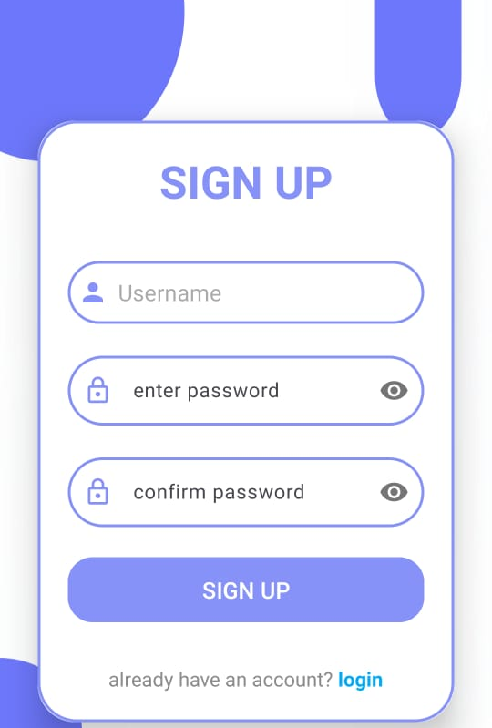
Sign up page
Authentication is made using firebase authentications

Slide 4
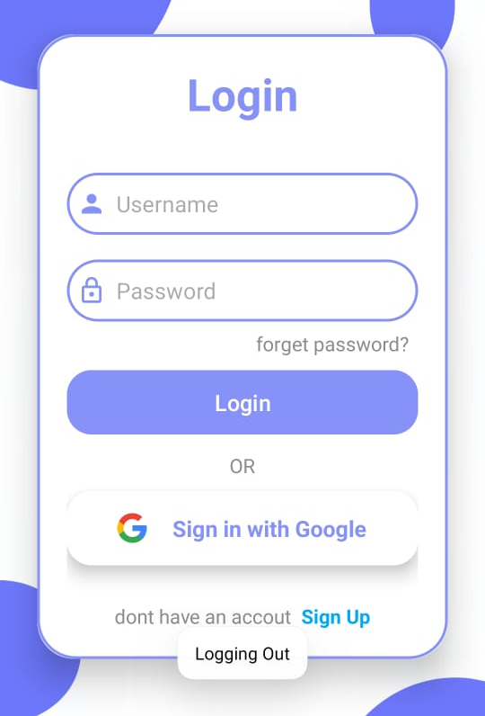
Login page
Login can be made by username and password or using normal google account

Slide 5
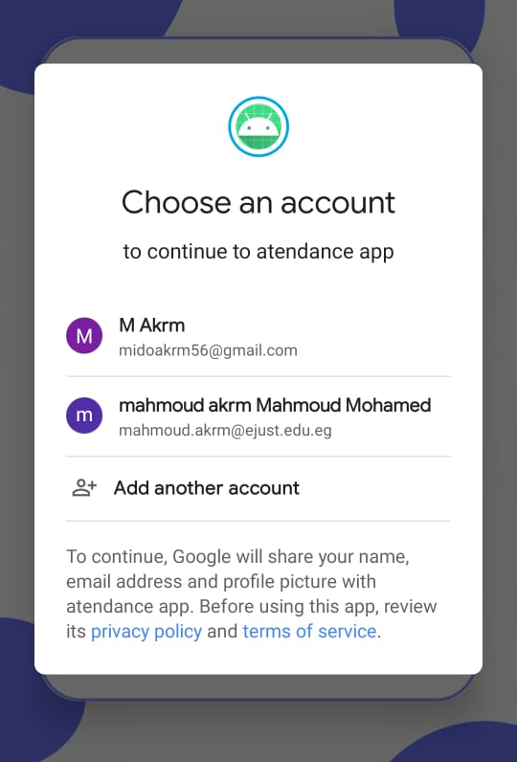
Login page
Accessing the google account in order to login

Slide 6
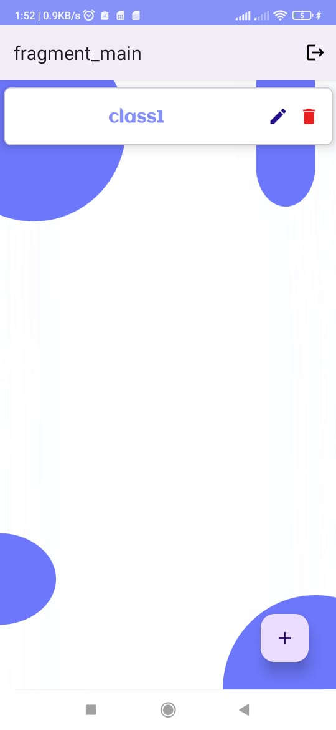
main page
Where user can access classes or add new class

Slide 7

week page
Where user can access weeks inside classes or add new week

Slide 8
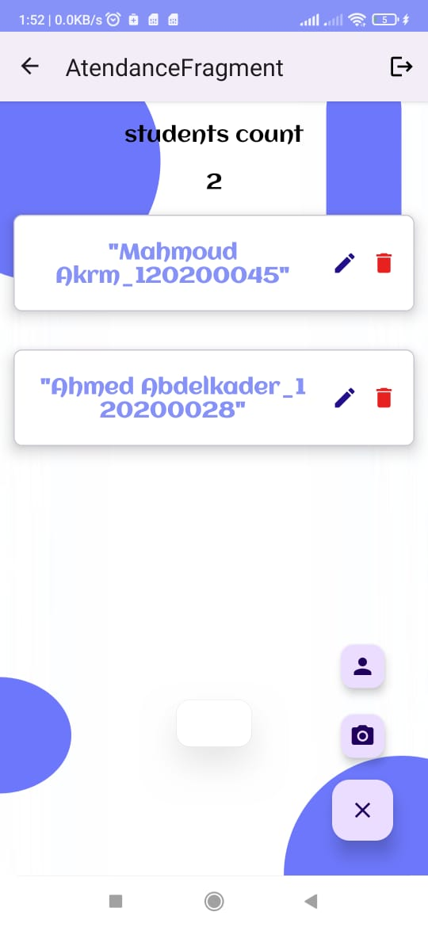
attendance page
Here user can view students that have attended this week and adding new students either by camera or manually . User can also edit existing students by changing their name or remove a student from the attendance

Slide 9
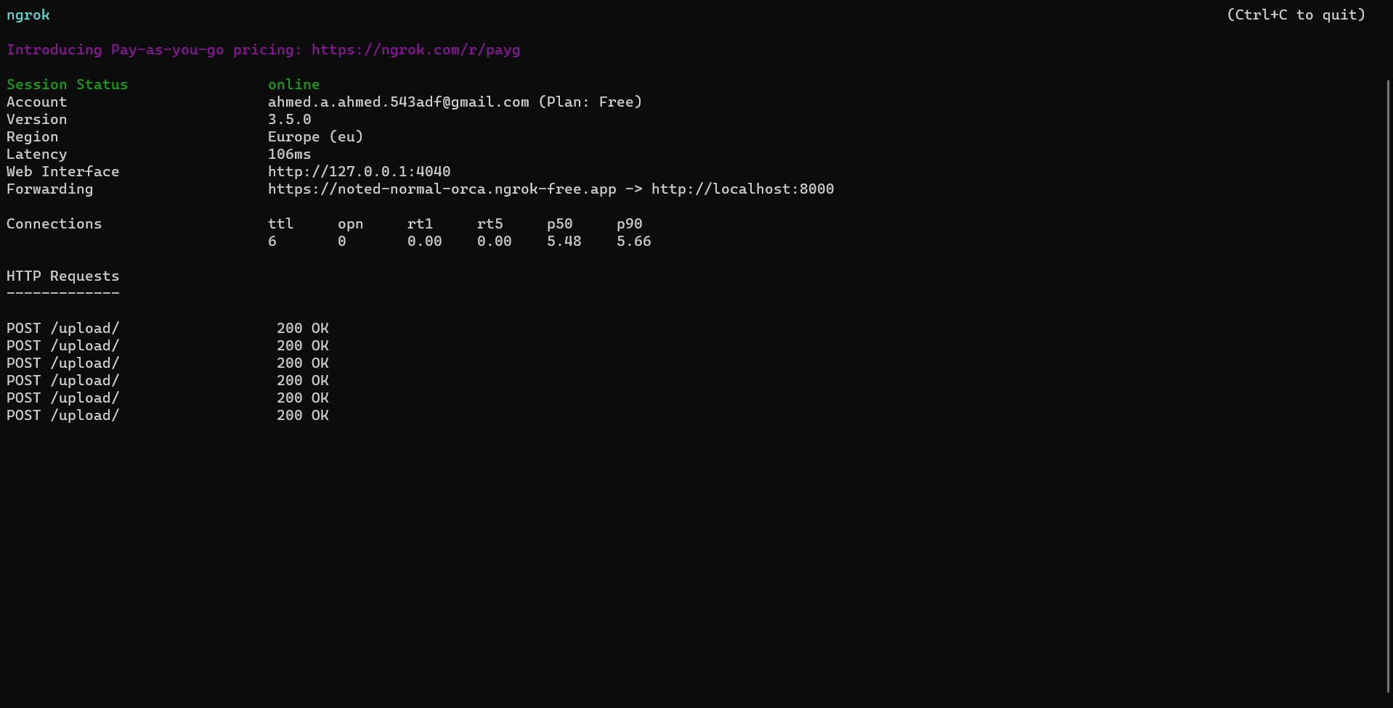
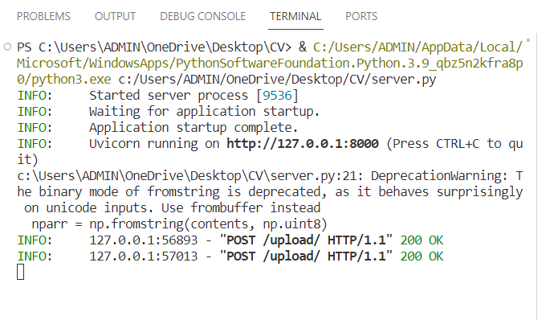
Ngrok SErver

Slide 10
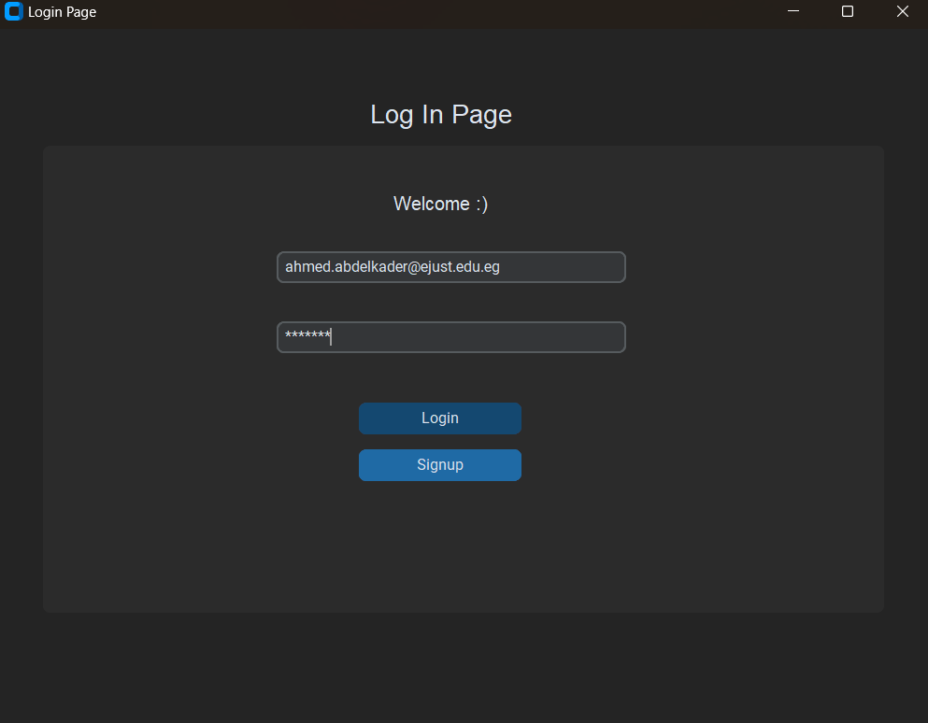
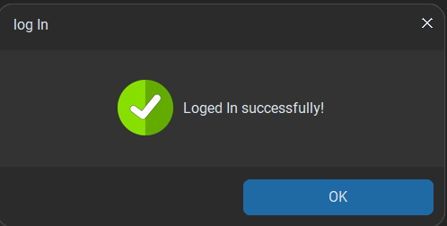
Python GUI LOG In

Slide 11
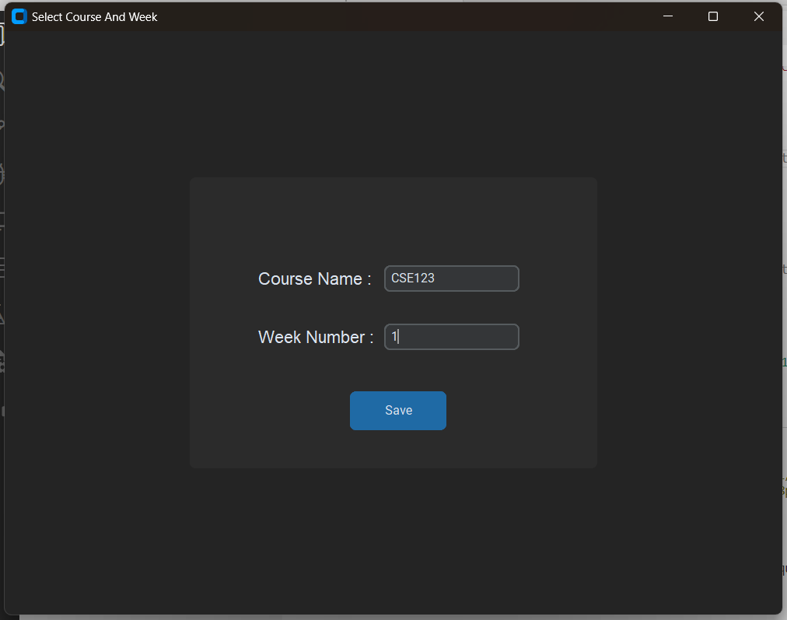
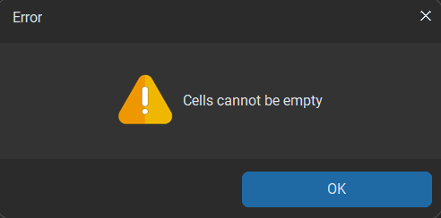
Python GUI Select course and week page

Slide 12
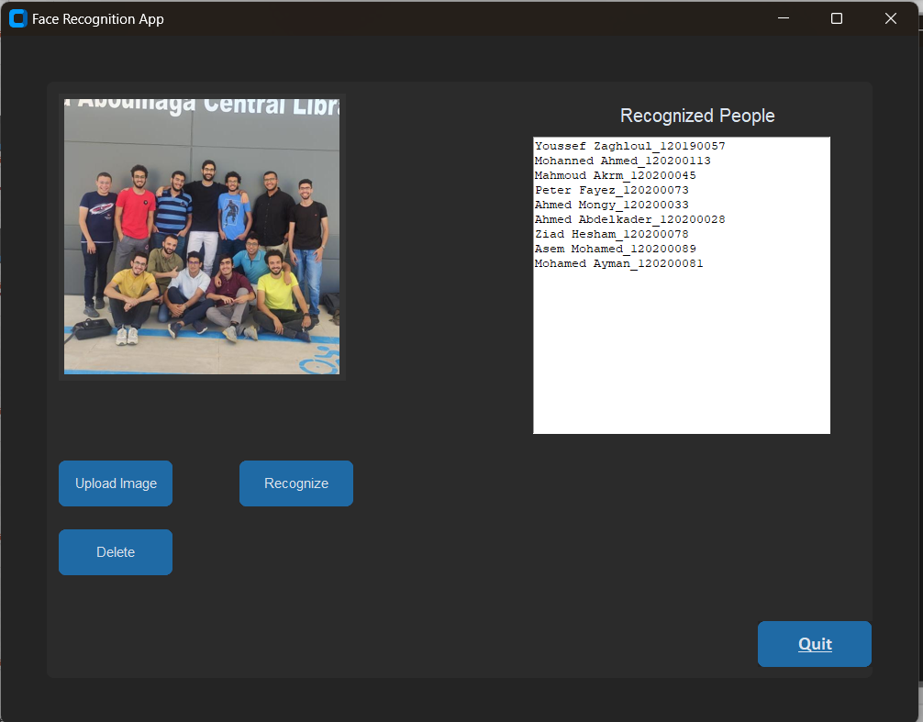
Face Recognition page

